Slide 1
Yelp Data Exploration and Analysis
ECE 143 FA20 Team 1
Bingxu(Vince) Chen, Ziwen Li, Zhimin Lin and Gaotong Wu
Presented by Gaotong Wu
Nov. 29, 2020
University of California, San Diego

Slide 2
The Yelp Dataset and Subset Selection
Businesses and users information since Dec. 2004.
5.2 million user reviews and ratings from over 1.96 million users.
174,000 businesses that mostly spans 11 metropolitan areas (including some outside the US).
In our project:
Consider only food and beverage providers (restaurants, bars, coffee shops, etc.)
Consider only businesses in the US that are still open.
Result: the number of businesses reduced to 22,730.
Notes:
Over 10 GB.

Slide 3
Methodology
Statistics: grouping and counting based on different criteria, e.g. ratings, types of cuisines, etc.
Word cloud: group review texts based on rating levels and then remove words (unigrams) with high frequencies. Then feed the texts into WordCloud library.
Sentiment analysis: feed all review texts for a single restaurant into the analysis model one restaurant at a time.

Slide 4
Users
Notes:
Let’s first look at...

Slide 5
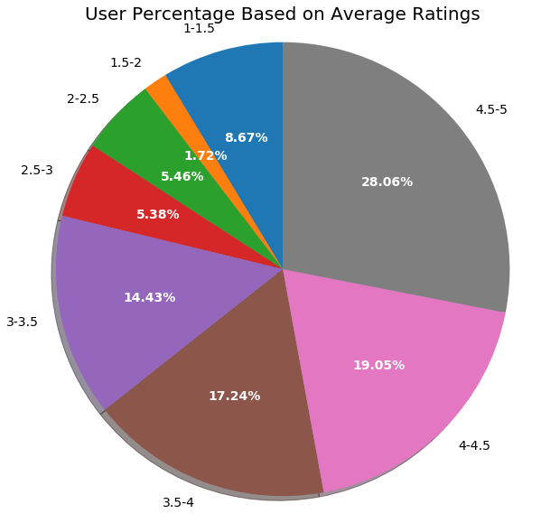
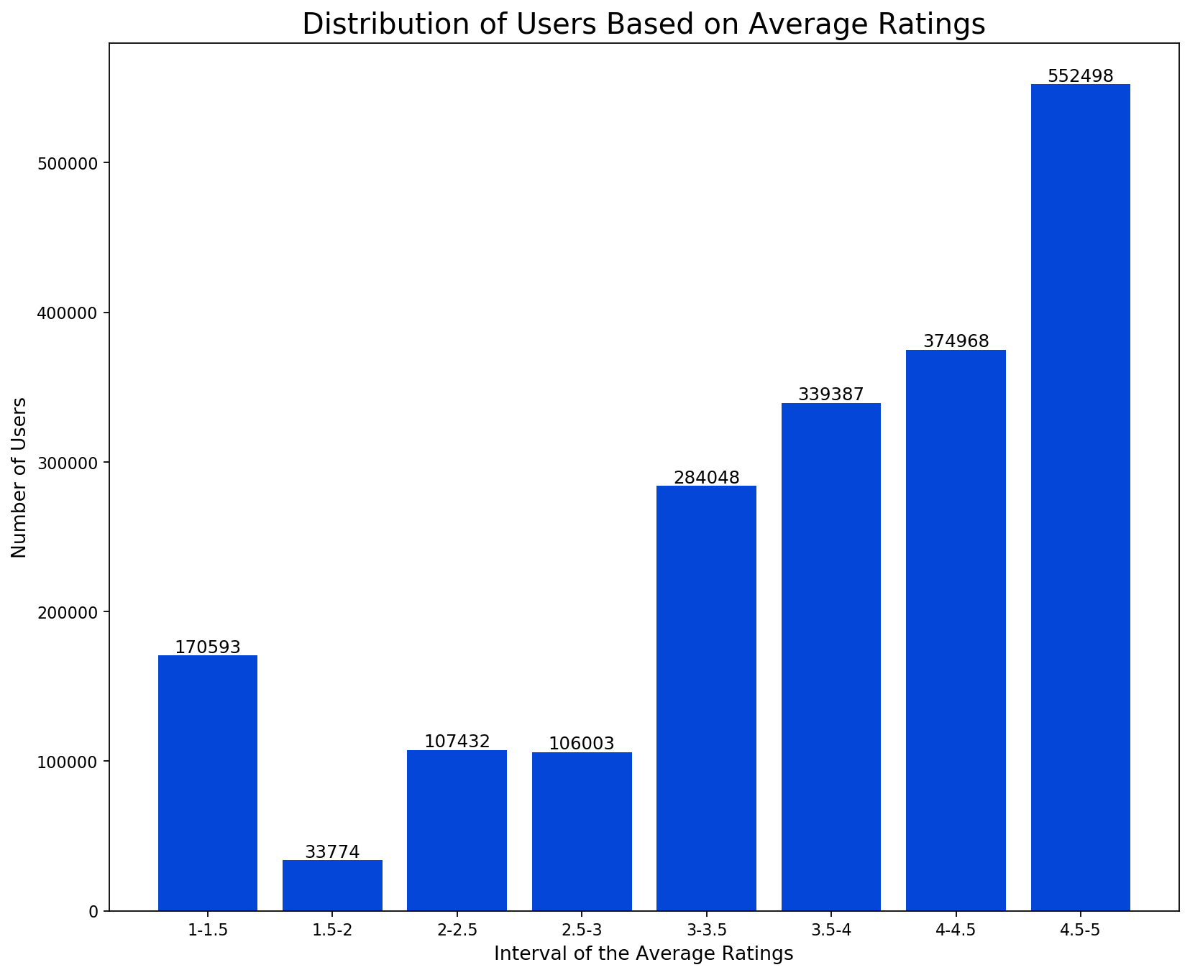
Most users tend to give high ratings
Notes:
Some might expect a normal distribution. But the truth is...

Slide 6
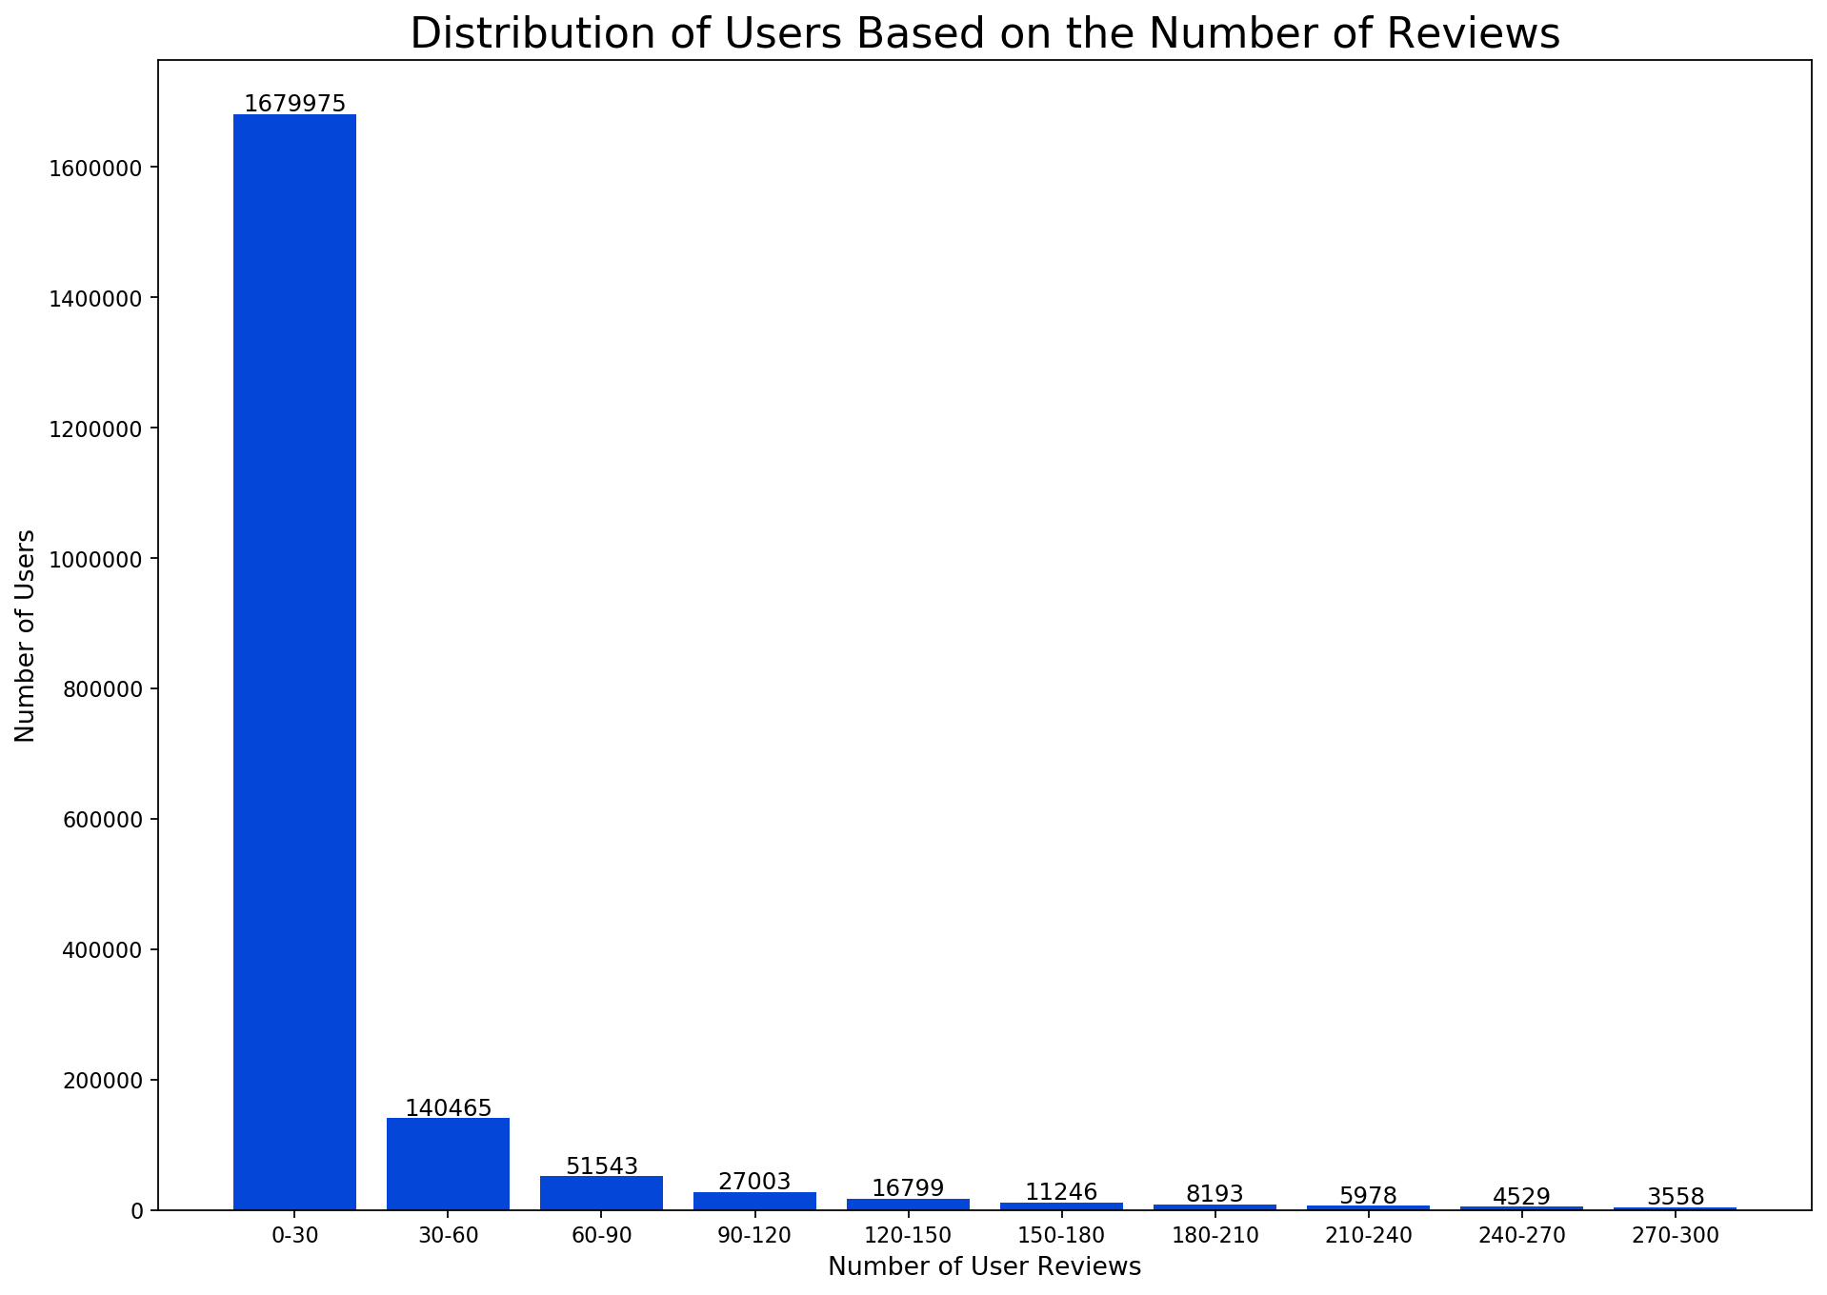
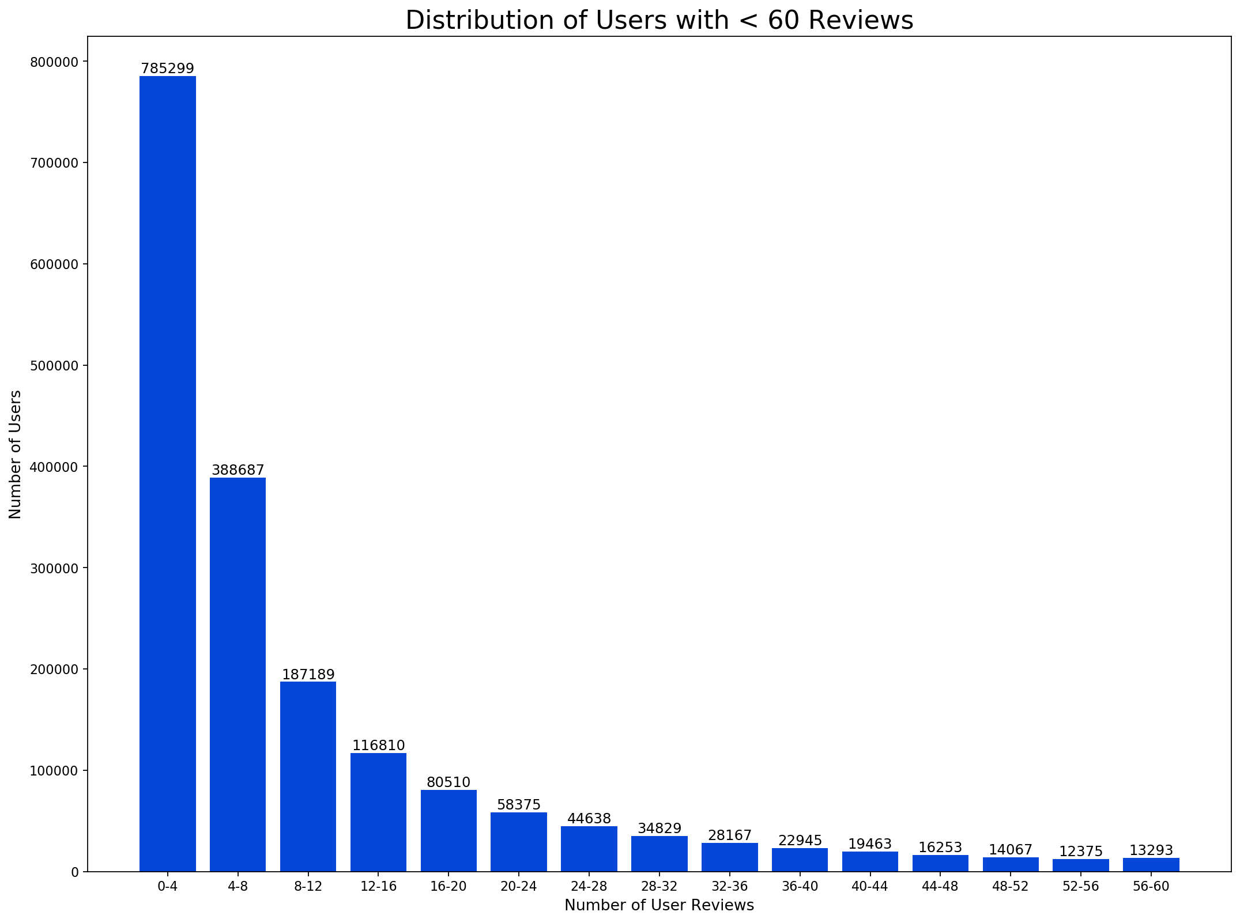
Most users write few reviews

Slide 7
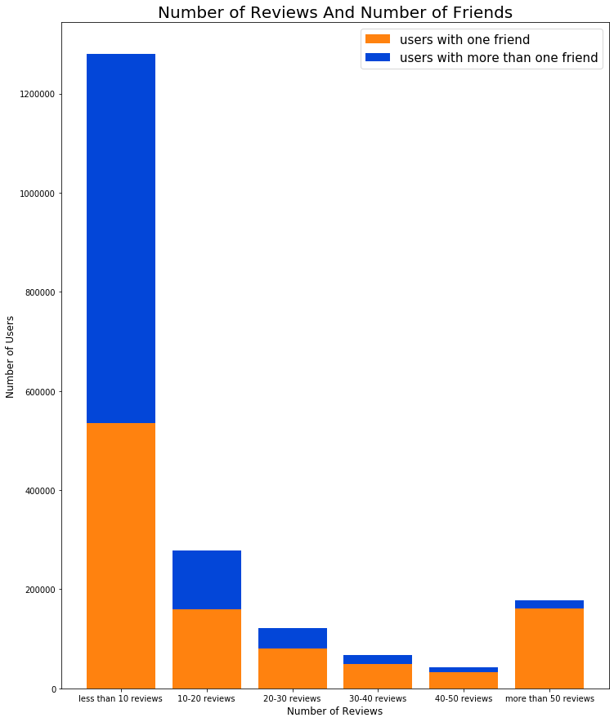
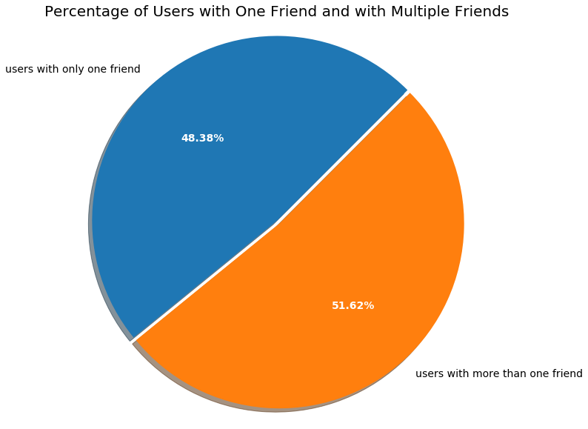
Almost half of the users have only 1 friend (on Yelp)
Notes:
Interestingly, all users in the dataset have at least one friend -- not sure why.
Most of the people willing to write more reviews have only 1 friend on Yelp.

Slide 8
Reviews and Ratings
Notes:
Now let’s take a deeper look into the reviews ratings, which are among the core functions of Yelp.

Slide 9
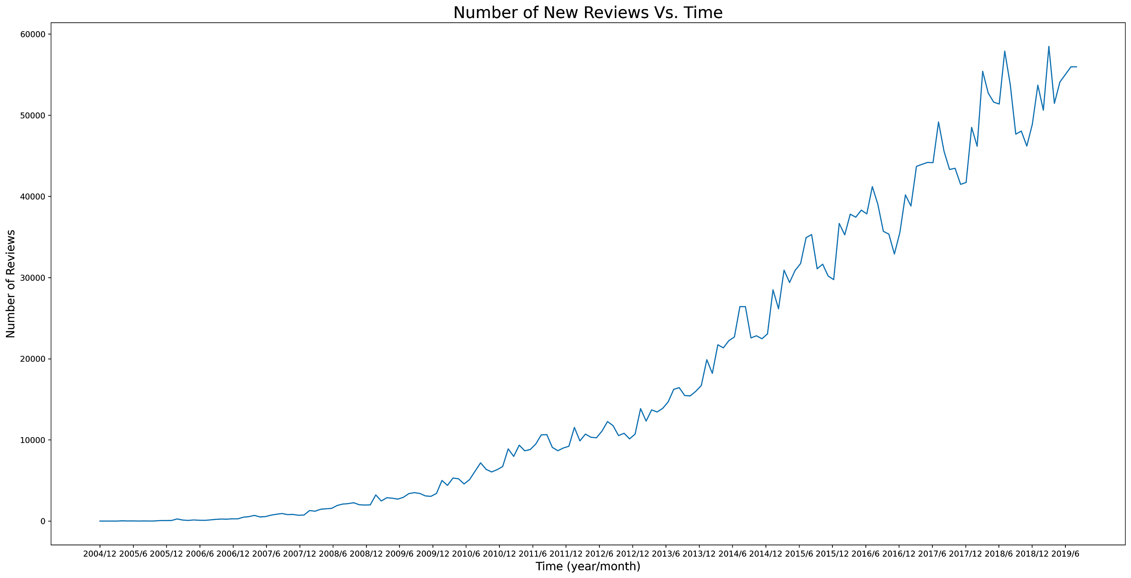
Fewest new reviews in December. Always.
Notes:
Reasons: Christmas? Financial? Or maybe people just feel less like writing a review?

Slide 10
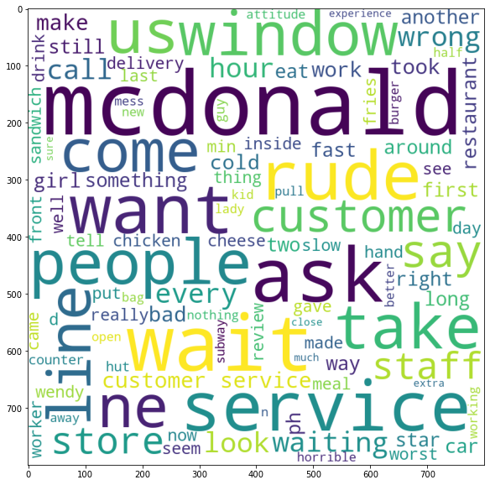
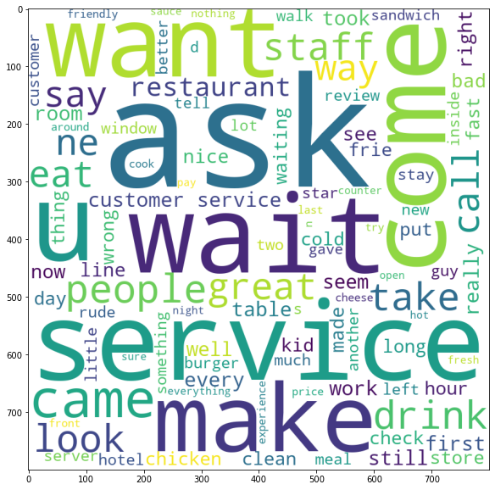
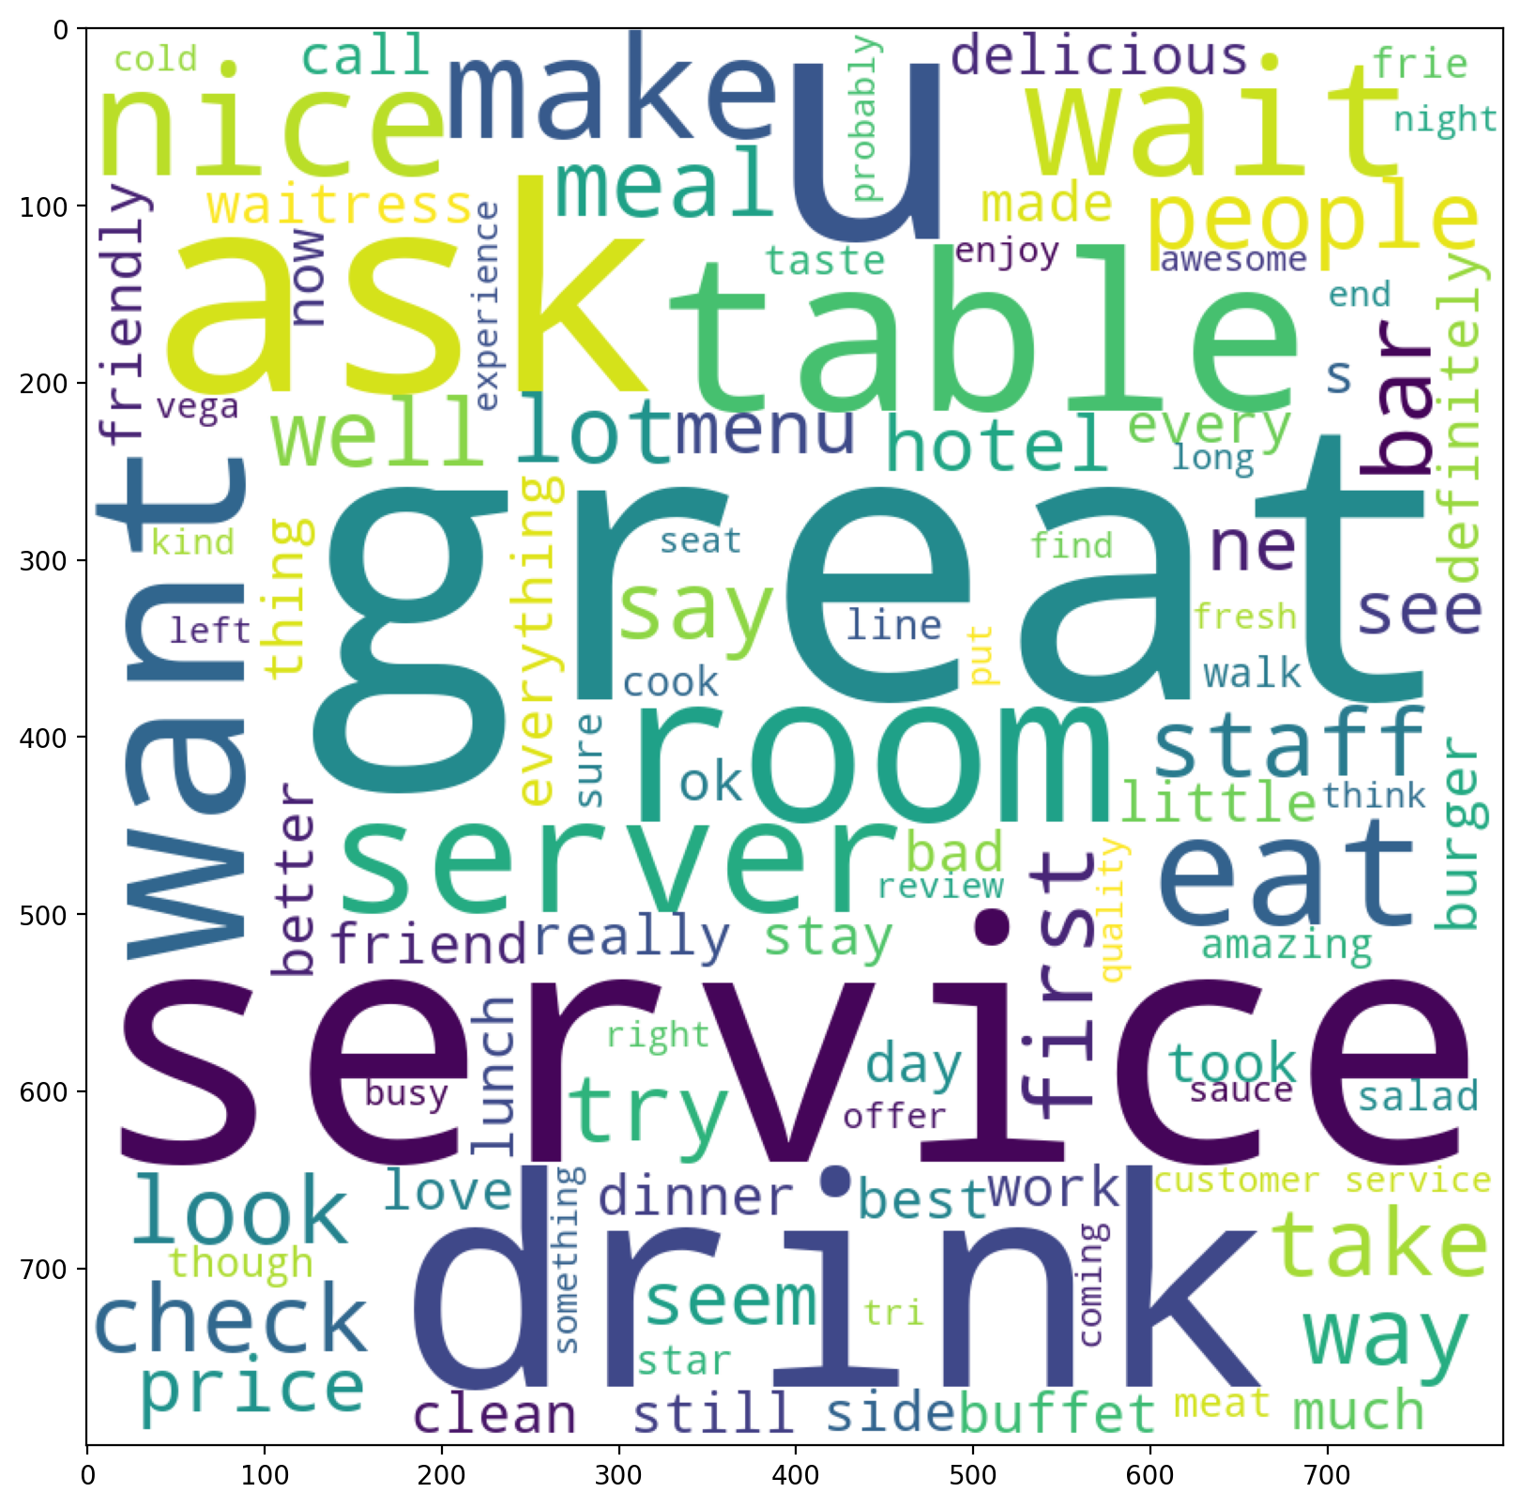
Word Clouds:
What do customers say about...
Businesses w/ 1 star rating
Businesses w/ 2 stars rating
Businesses w/ 3 stars rating
Notes:
1star: wrong, rude, horrible, bad, slow
2star: slightly better
3 star: neutral

Slide 11
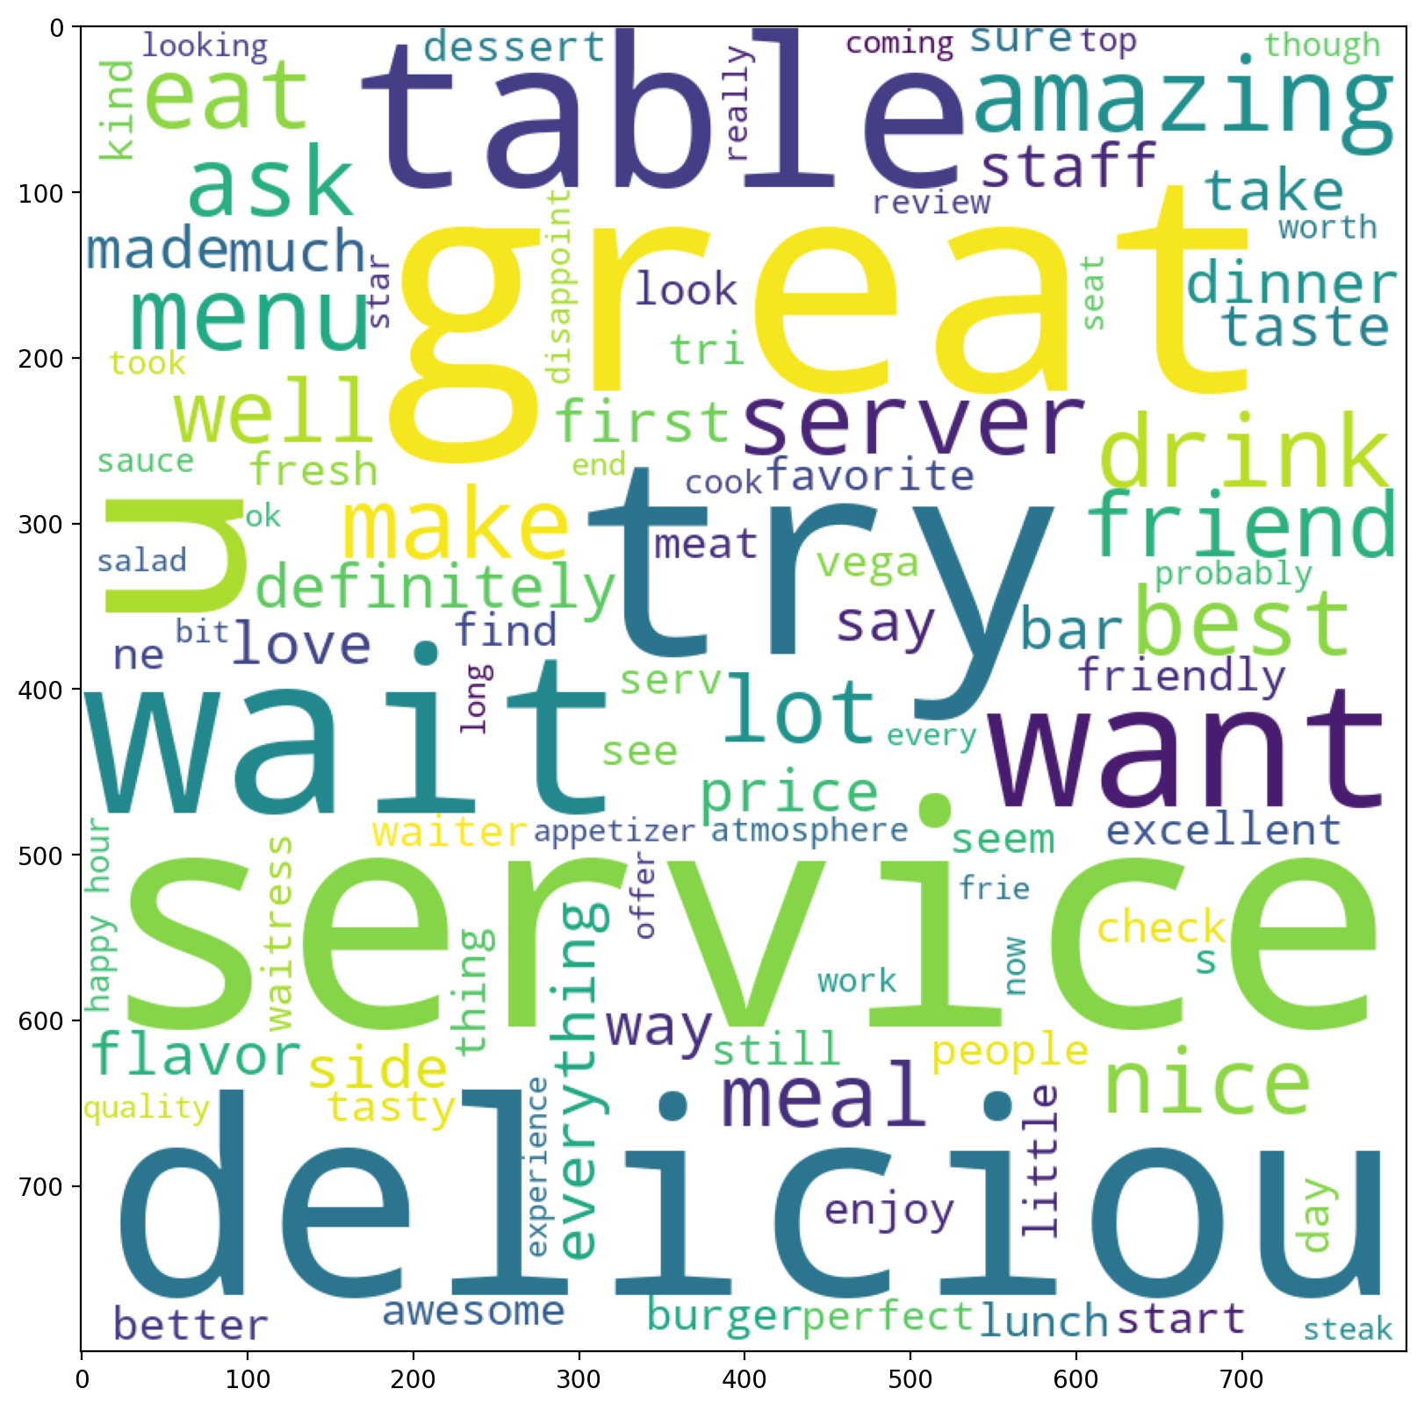
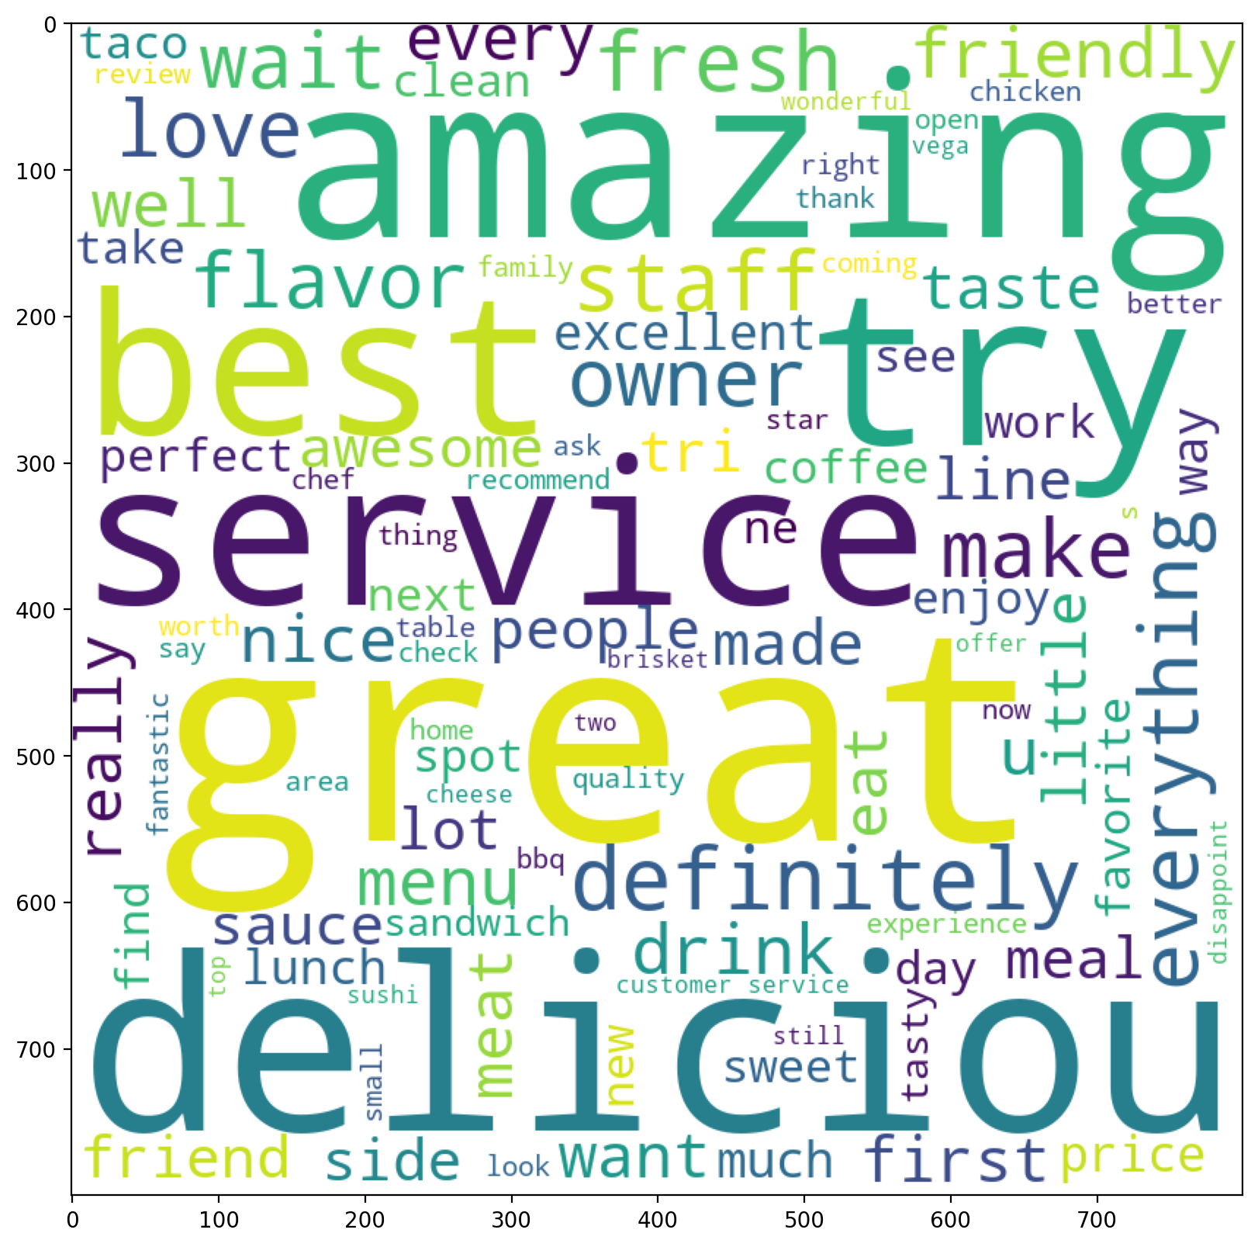
Word Clouds:
What do customers say about...
Businesses w/ 4 stars rating
Businesses w/ 5 stars rating

Slide 12
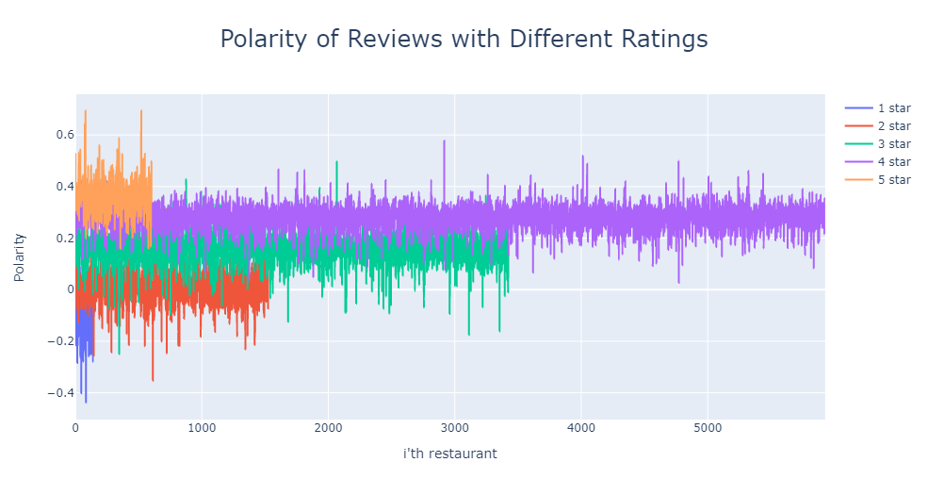
Sentiment Analysis: happy vs. unhappy
Polarity = 1: very positive
Polarity = -1: very negative
Results (average): 1 star: -0.108; 2 stars: 0.011; 3 stars: 0.158; 4 stars: 0.280; 5 stars: 0.363

Slide 13
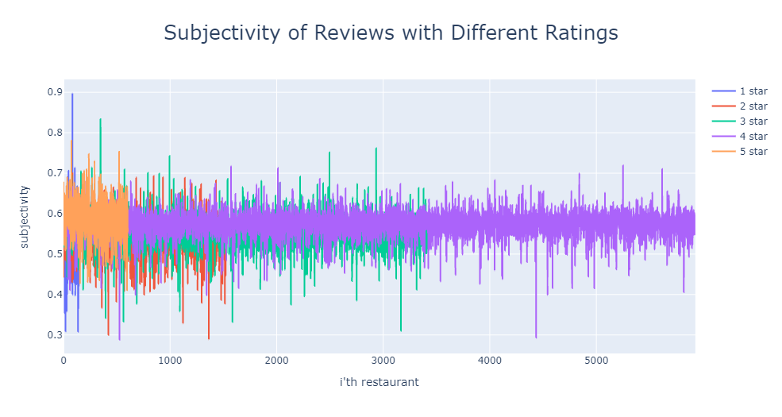
Sentiment Analysis:
are reviews entirely subjective?
Subjectivity = 1: totally subjective
Subjectivity = 0: totally objective
Results (average): 1 star: 0.56; 2 stars: 0.58; 3 stars: 0.55; 4 stars: 0.54; 5 stars: 0.59
Notes:
Conclusion:
1 star to 5 star: all center between 0.5-0.6 on average, subjective;
Customers review based on their personal feeling and emotion;

Slide 14
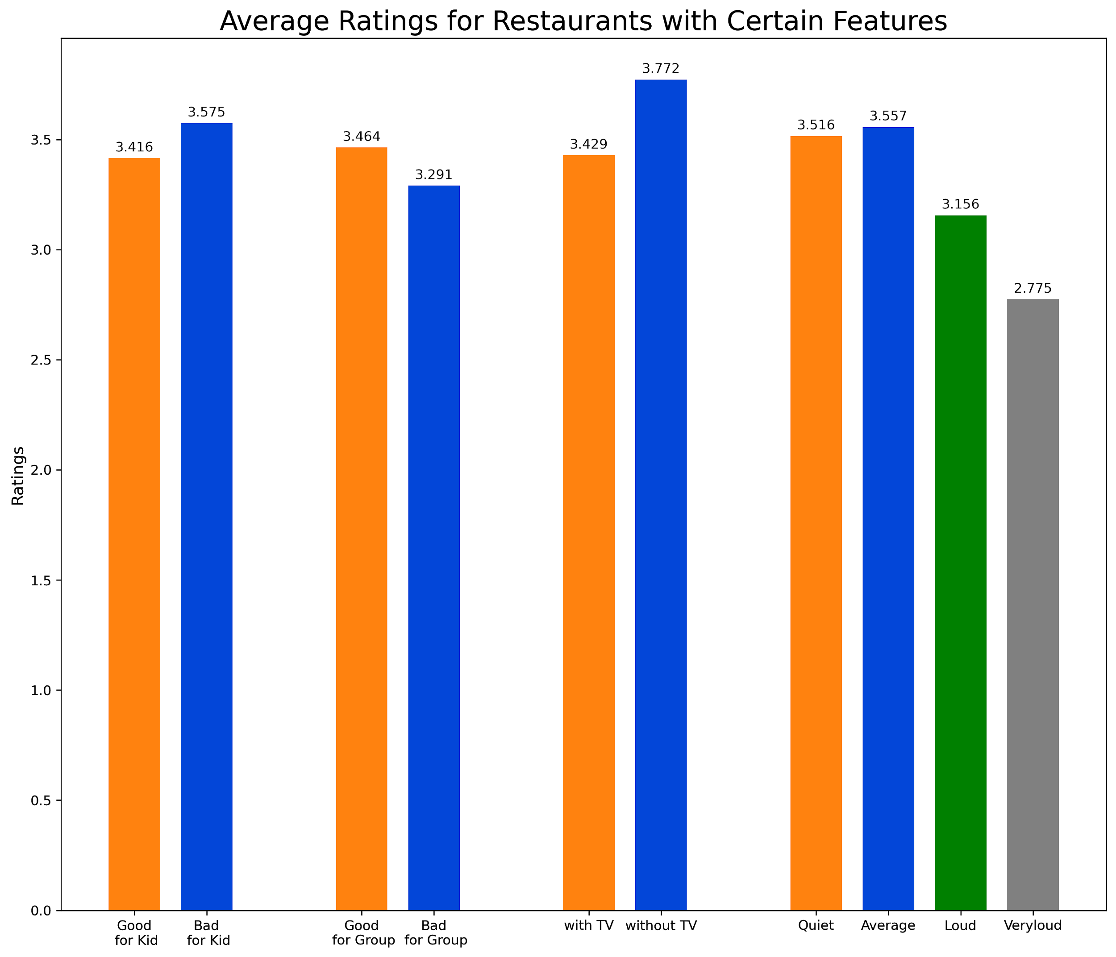
Some businesses receive
higher ratings
Those that are bad for kids generally rated higher.
Those that are good for groups generally rated higher.
People like quiet places.
Notes:
Businesses that are bad for kids are rated higher in general.
Others are basically as expected.

Slide 15
Cuisines

Slide 16
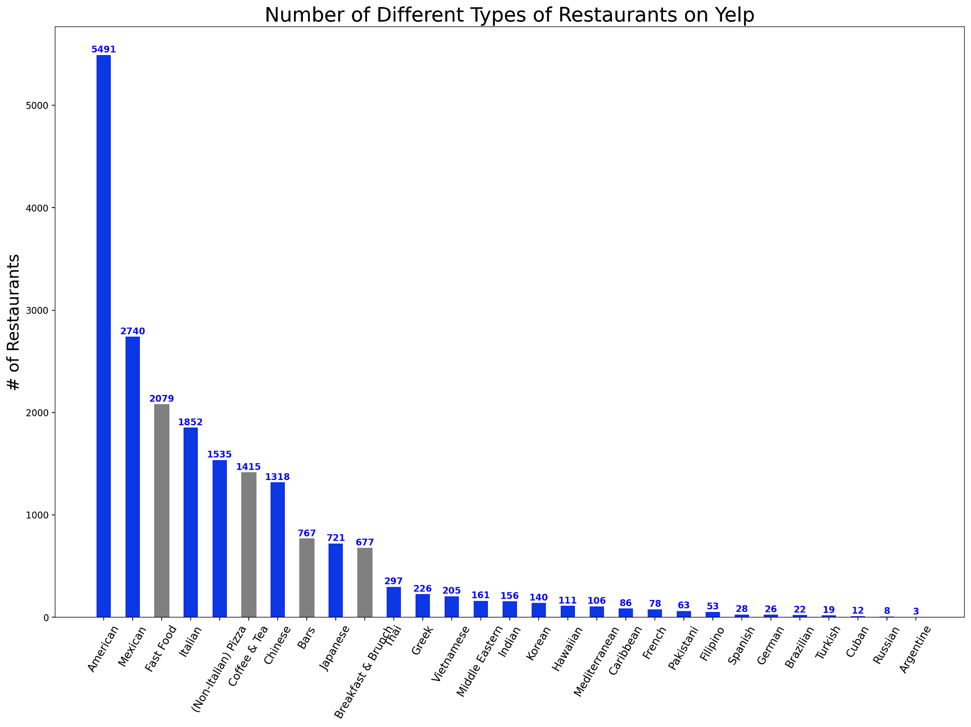
Overview
Notes:
Grey bars: non-restaurants.
American leads in America.
Big drops: America -> Mexican, Chinese -> Japanese -> Thai
Minor cuisines on the tail.
Only represents what we have on Yelp. May not be a full picture of the reality.

Slide 17
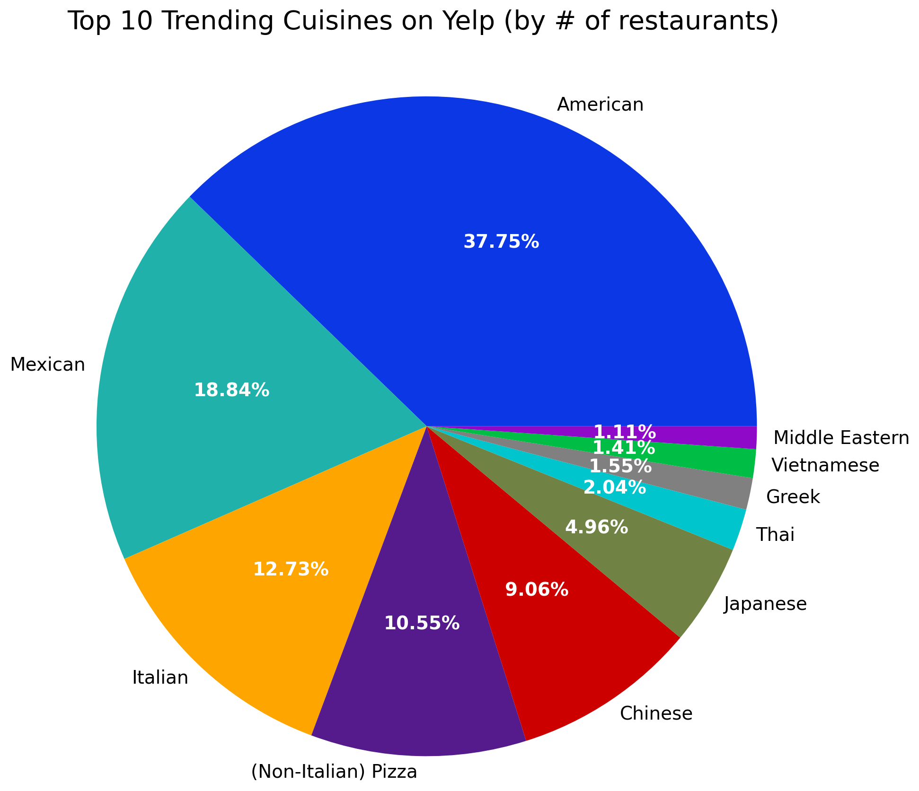
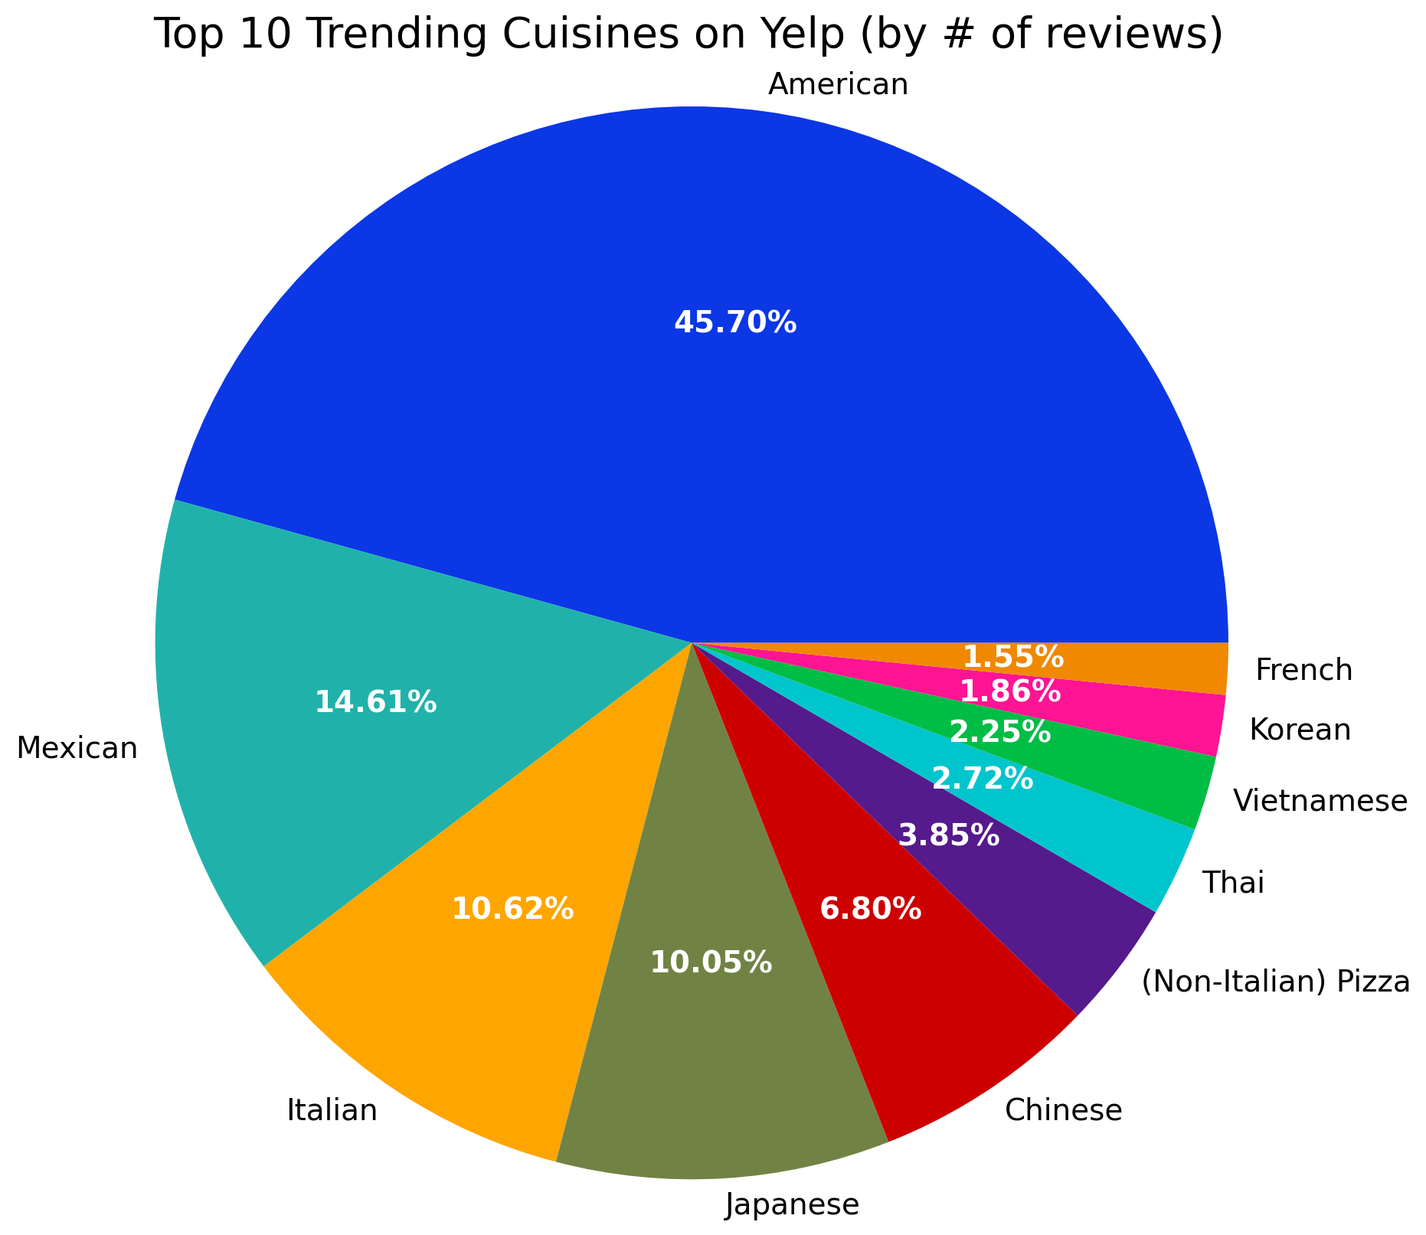
What is trending on Yelp?

Slide 18
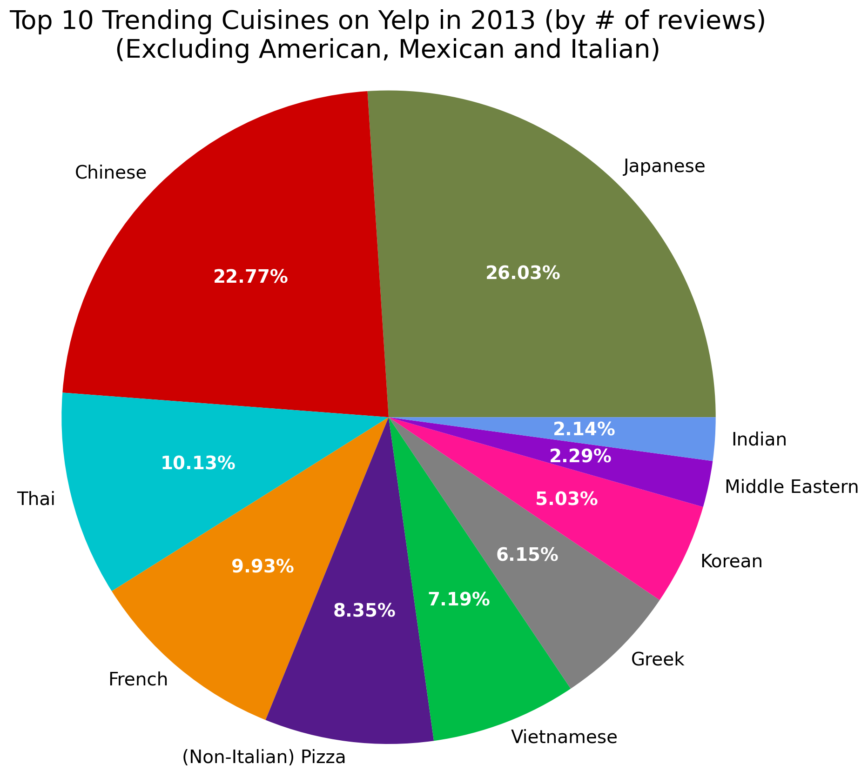
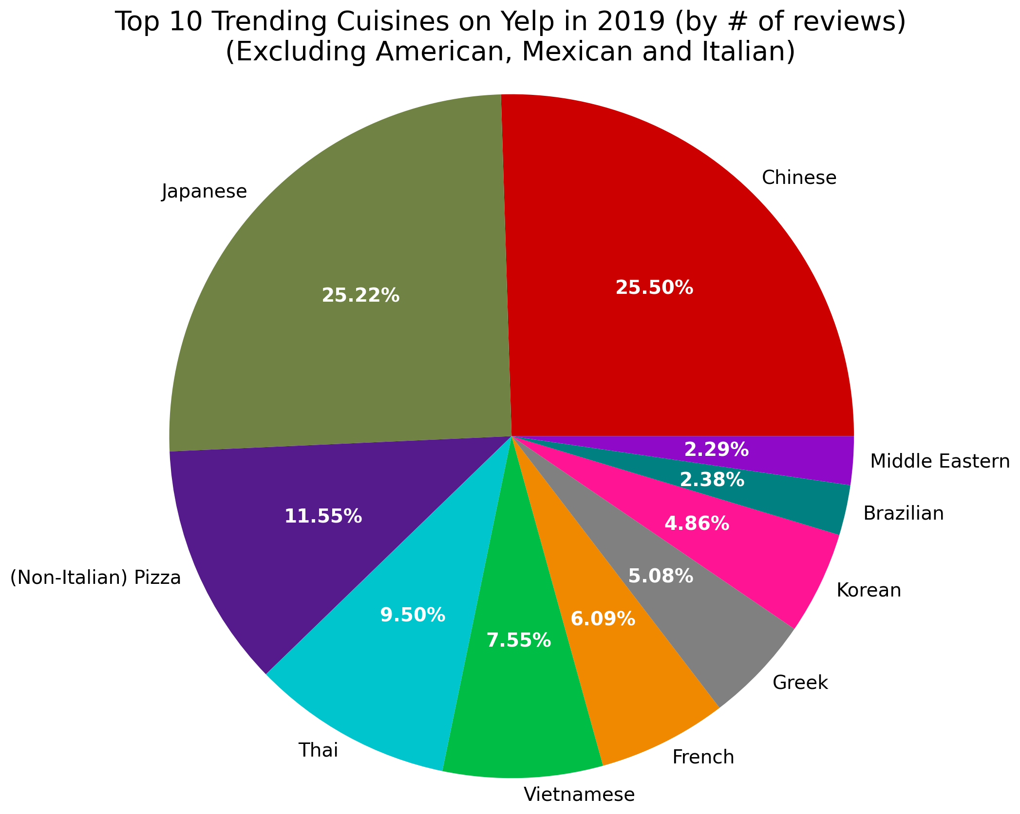
(Active) Users’ tastes change over time
Notes:
Notice the rank of Chinese and Japanese switched.
Korean goes up. French drops down.
Others are relatively unchanged.
Middle Eastern disappeared -- the only one dropped out. Replaced by Hawaiian.

Slide 19
Thank you!

